Slide 1
Chapter 52

Slide 2
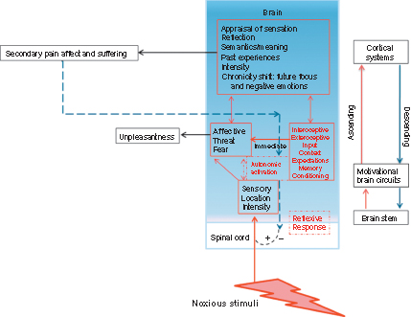
Figure 1 Integrated conceptual model of the pain experience. Nociceptive input extends through the periphery to the spinal cord via the dorsal horn through the anterolateral system to a complex array of subcortical and cortical areas including but not limited to the brainstem, thalamus, forebrain, and somatosensory cortex (red lines). Pain affective and motivational processing also involves an extensive network of brain structures that act in unison and sequentially, communicating through multiple ascending (red lines) and descending (blue lines) pathways involving brainstem, subcortical and cortical regions. The dorsal horn also integrates information from descending pathways, which modulates the flow of nociceptive information back to the higher structures. (Components in the model were informed and influenced by the work and teachings of Donald D. Price, PhD.)

Slide 3
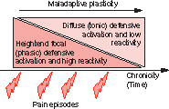
Figure 2 Chronic pain and discrimination between aversive and nonaversive states. The initial experience of pain is associated with strong, focal defensive/aversive system activation. With increasing chronicity, maladaptive plasticity in defensive/stress systems is hypothesized to accompany a pathological trajectory toward diffuse (indiscriminate) and chronic defensive engagement, associated with diminished reactivity to specific events.

Slide 4
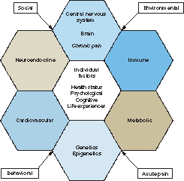
Figure 3 Pain, individual factors, and biological systems. Conceptual model illustrating the biological interface of the individual experience of pain. Individual factors (center) include but are not limited to internal (e.g., health status, psychological, cognitive, life experiences) and external (e.g., social, behavioral, environmental, and acute pain events). Surrounding shapes, the primary and secondary biological systems associated with the stress response.

Slide 5
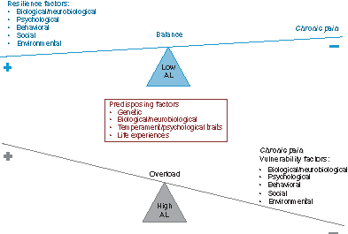
Figure 4 Chronic pain, allostatic load (AL), and potential clinical targets. There are a number of potential interventions that may help reduce the AL of chronic pain by reducing vulnerability factors (e.g., inadequate sleep, lack of exercise, obesity, smoking, poor quality diet, social isolation, maladaptive pain coping strategies) while enhancing resiliency factors (e.g., healthy diet, exercise, yoga, adaptive pain coping strategies, sound sleep, social support).

